Slide 1
MIDEA | TOSHIBA
Who to contact at
Midea MME
Find the function you need, open it, and reach the right person.
GCC UAE · Kuwait · Bahrain · Qatar · Oman LEVANT Jordan · Lebanon · Iraq · Syria · Israel · Palestine
Middle East & Levant · 2026
mme-contacts.pages.dev
Notes:
Partner-facing contact directory for Midea MME. Same content as the live web directory.

Slide 2
The teams
Seven functions, 29 people across GCC & Levant.
General Management
Product Management
Marketing
Sales
Entity leadership
Range, specifications and launches
Brand, retail and trade marketing
Commercial ownership by market
1 person
6 people
6 people
6 people
Sales Commercial
After Sales Service
Finance
Orders, coordination and shipping
Warranty, parts and technical
Invoices, credit and FP&A
4 people
4 people
2 people

Slide 3
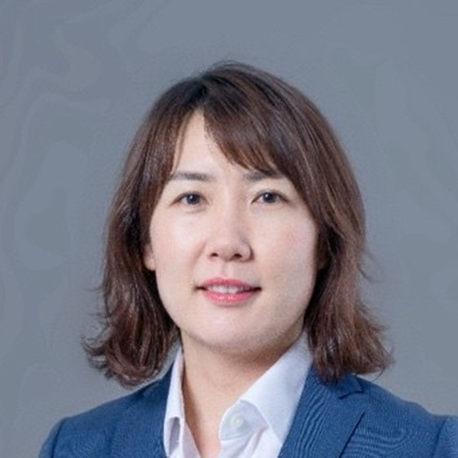
General Management
1 PERSON
Entity leadership
Paris Li
General Manager — Midea Middle East
paris.li@midea.com
GCC & Levant

Slide 4
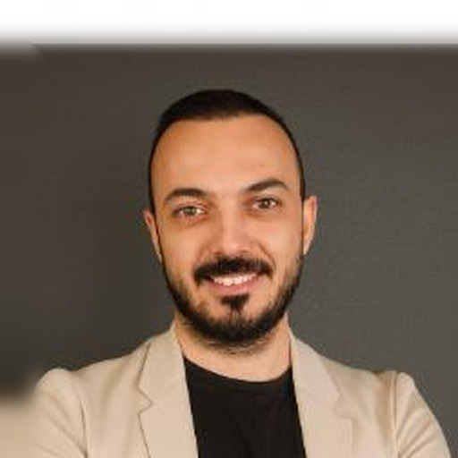
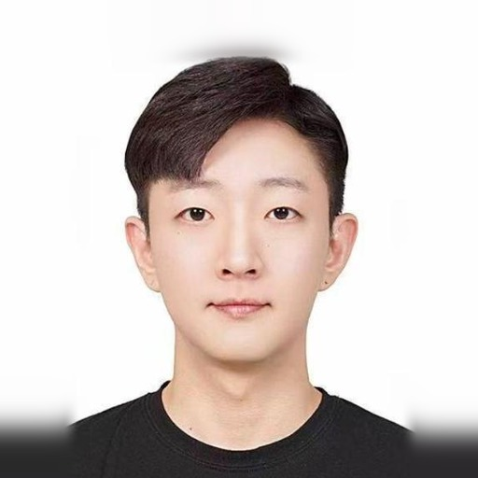

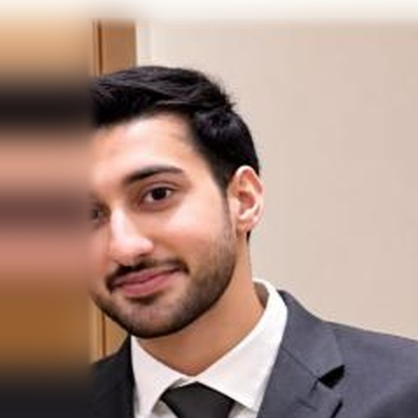
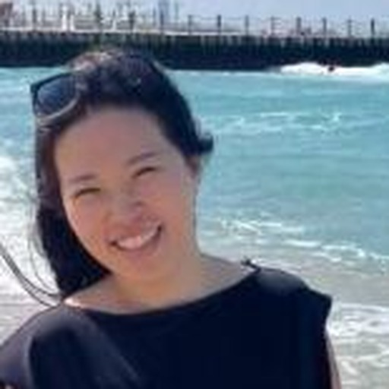

Product Management
6 PEOPLE
Range, specifications and launches
Tevfik Mert Yilmaz
Seung Woo Oh (Matthew)
Zeynep Nemutlu
Head of Product Management
Product Manager — REF + RAC
Product Manager
tevfik.yilmaz@midea.com
seungwoo.oh@midea.com
zeynep.nemutlu@midea.com
GCC & Levant
GCC & Levant
GCC & Levant
Mohideen Nazeer
Yujin Jung
Muhammad Zahid Chohan
Product Manager — MOA + Built-in
Product Manager — SDA + Water Dispenser
Product Specialist — MOA + Built-in
mohideen.nazeer@midea.com
yujin.jung@midea.com
muhammad.zahid@midea.com
GCC & Levant
GCC & Levant
GCC & Levant

Slide 5
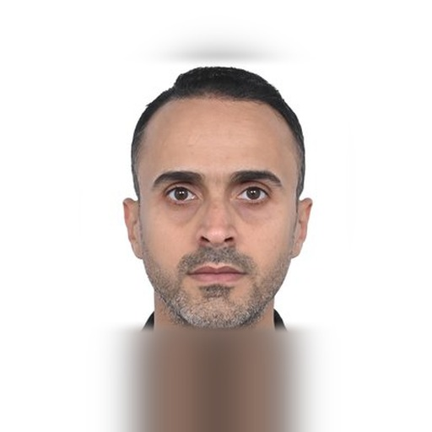
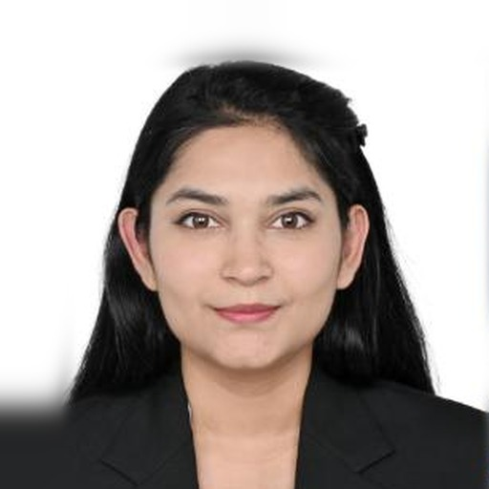

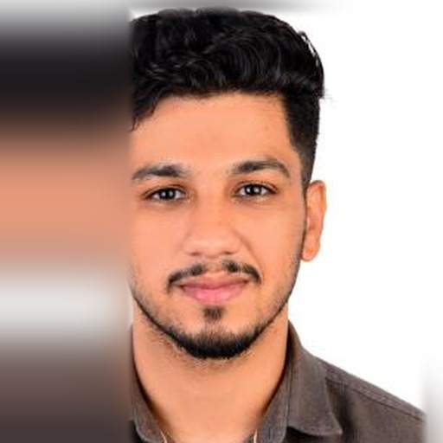
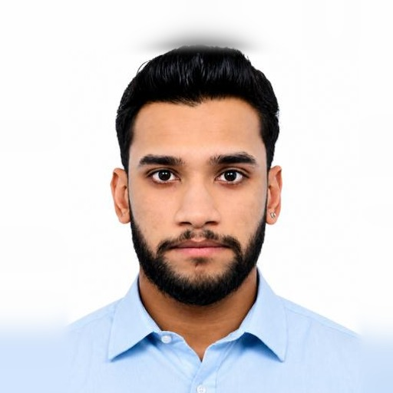

Marketing
6 PEOPLE
Brand, retail and trade marketing
Ahmed Soliman
Simran Mittal
Nour Abi Faraj
Head of Marketing
Senior Marketing Specialist — Brand & Digital Marketing
Branding, Digital & Event Management
ahmedsoliman.m@midea.com
simran.mittal@midea.com
nour.faraj@midea.com
GCC & Levant
GCC & Levant
GCC & Levant
Ahmed Mohamed Tawfik
Gautam Najeen
Ahmed Adel Ramadan
Retail Management — GCC
Visual Merchandiser — Trade Marketing
Product Training Manager
ahmed.t@midea.com
gautam.najeen@midea.com
ahmed4.ramadan@midea.com
GCC & Levant
GCC & Levant
GCC & Levant

Slide 6
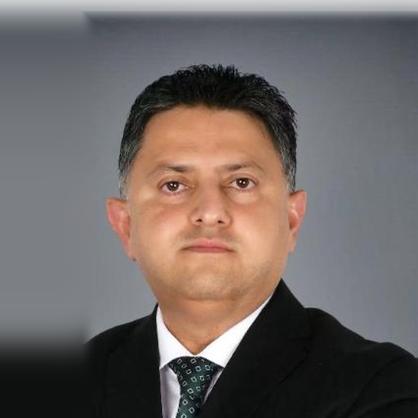

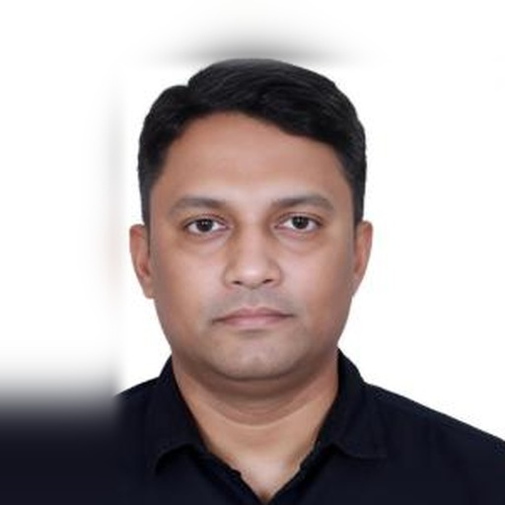
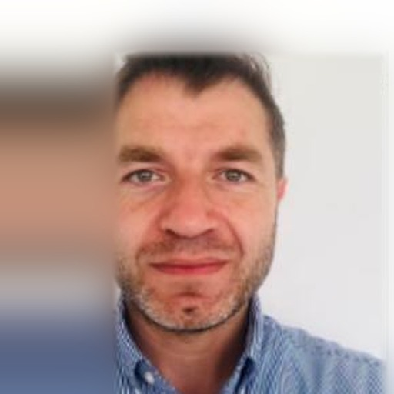
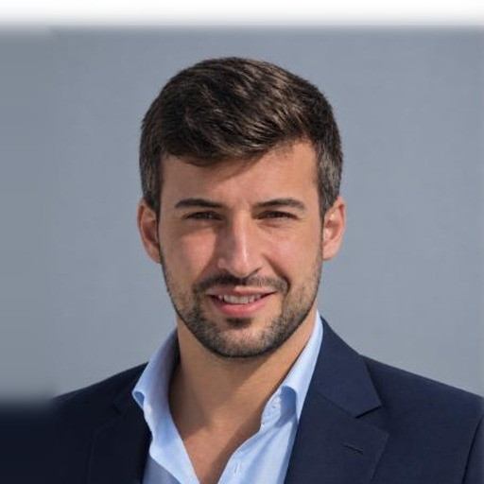
Sales
6 PEOPLE
Commercial ownership by market
Syed Hammad Ahmed
Suhaib Ashraf
Vinu Chandy
Head of Sales
Key Accounts — Bahrain & Qatar
Country Manager — Oman
syed.hammad@midea.com
suhaib.ashraf@midea.com
vinu.chandy@midea.com
GCC & Levant
GCC · Bahrain & Qatar
GCC · Oman
OP
Open position
Ahmad Jamal Abu Dheir
Diego Rodriguez Gonzalez
Country Manager — Kuwait
Levant Sales Head
Export Manager — TEKA
Contact details to be confirmed
ahmad.abudheir@midea.com
diego.gonzalez@midea.com
GCC · Kuwait
Levant
GCC & Levant

Slide 7
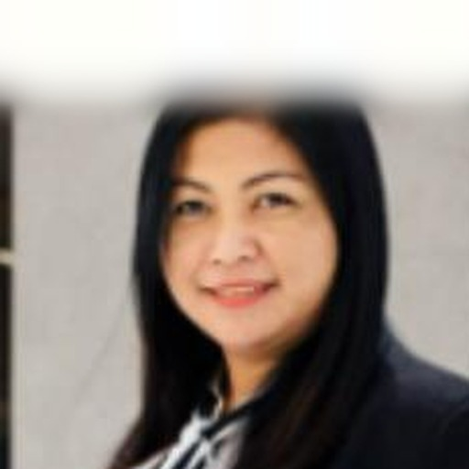
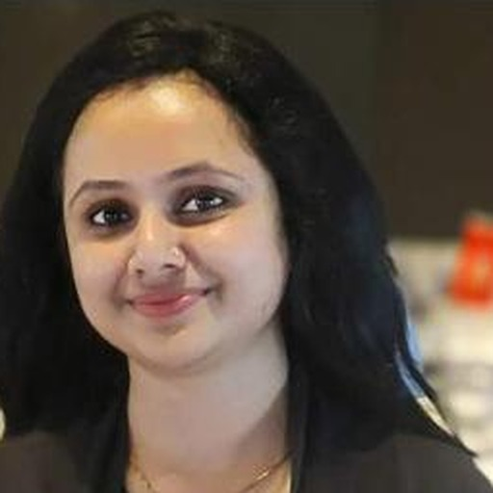

Sales Commercial
4 PEOPLE
Orders, coordination and shipping
Nanet Villanueva Paloma
Dhanya Anoop
Deepa Gangwani
Sales Coordinating Assistant Manager
Sales Coordinator — Levant + TEKA
Sales Coordinator — GCC
nanet.paloma@midea.com
Contact details to be confirmed
Contact details to be confirmed
GCC & Levant
Levant
GCC
A梁
Alina (梁芬)
Order Management
Contact details to be confirmed
GCC & Levant

Slide 8
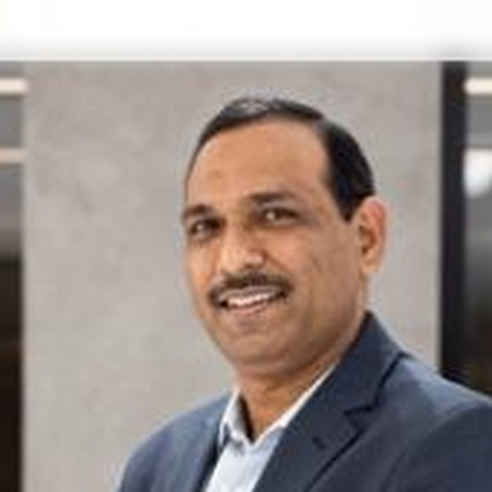
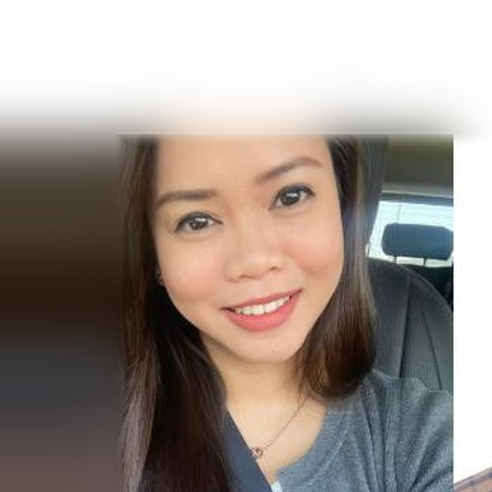
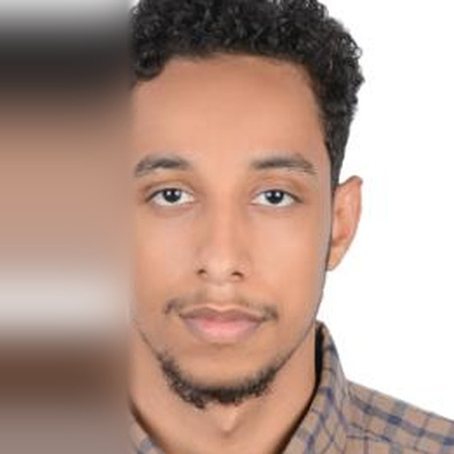
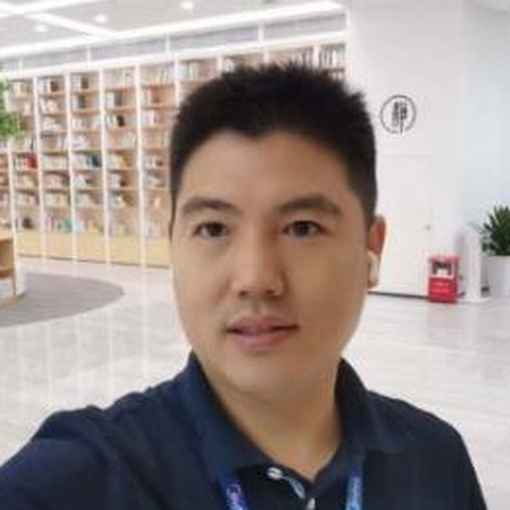
After Sales Service
4 PEOPLE
Warranty, parts and technical
Mohammad Waseem Ansari
Joriel Pechon
Nasir Mohamed Idress
Head of After Sales Service
Assistant Spare Parts Manager
Service Coordinator
ansari.waseem@midea.com
joriel.pechon@midea.com
nasir.m@midea.com
GCC & Levant
GCC & Levant
GCC & Levant
Leven Liu (刘千林)
Service Manager — Levant
leven.liu@midea.com
Levant

Slide 9
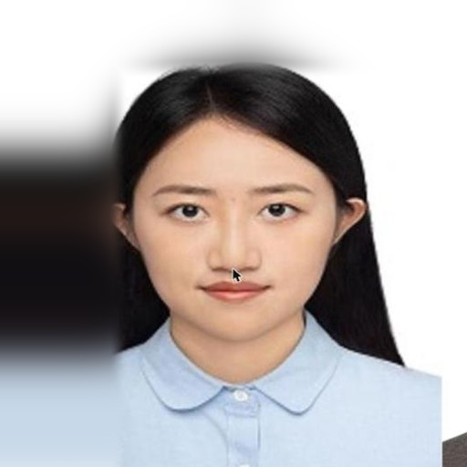
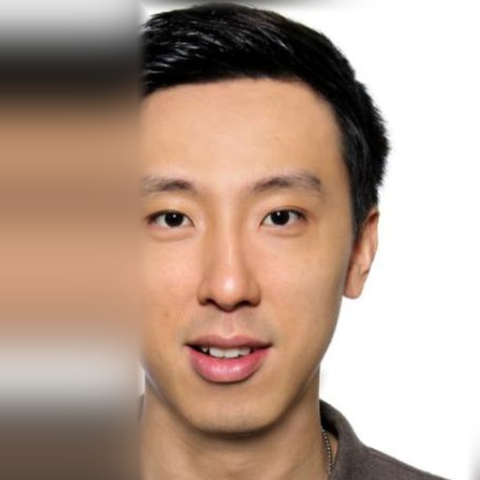
Finance
2 PEOPLE
Invoices, credit and FP&A
Stella (方恬恬)
Kai Mun (刘旂闻)
Head of Finance
FP&A — Middle East
Contact details to be confirmed
kaimun.low@midea.com
GCC & Levant
GCC & Levant

Slide 10
Always current online
The live directory carries the same contacts, with search, one-tap call, email and WhatsApp.
It is updated as the team changes — this deck is a snapshot.
mme-contacts.pages.dev
Something wrong or missing? Tell Ahmed Soliman — ahmedsoliman.m@midea.com

